Slide 1
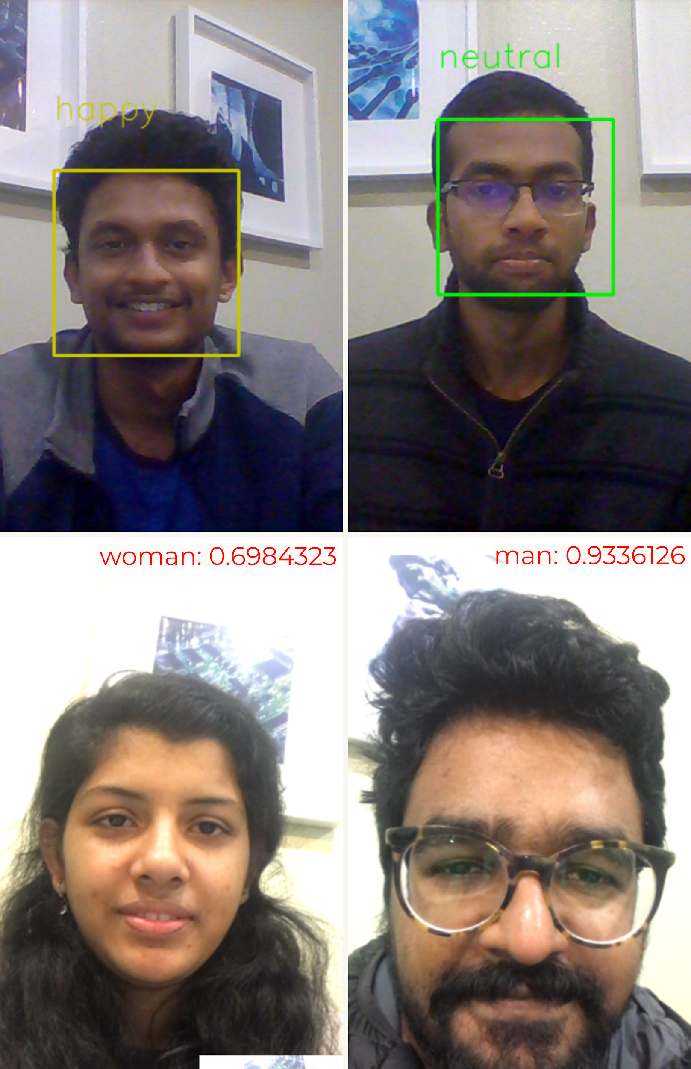
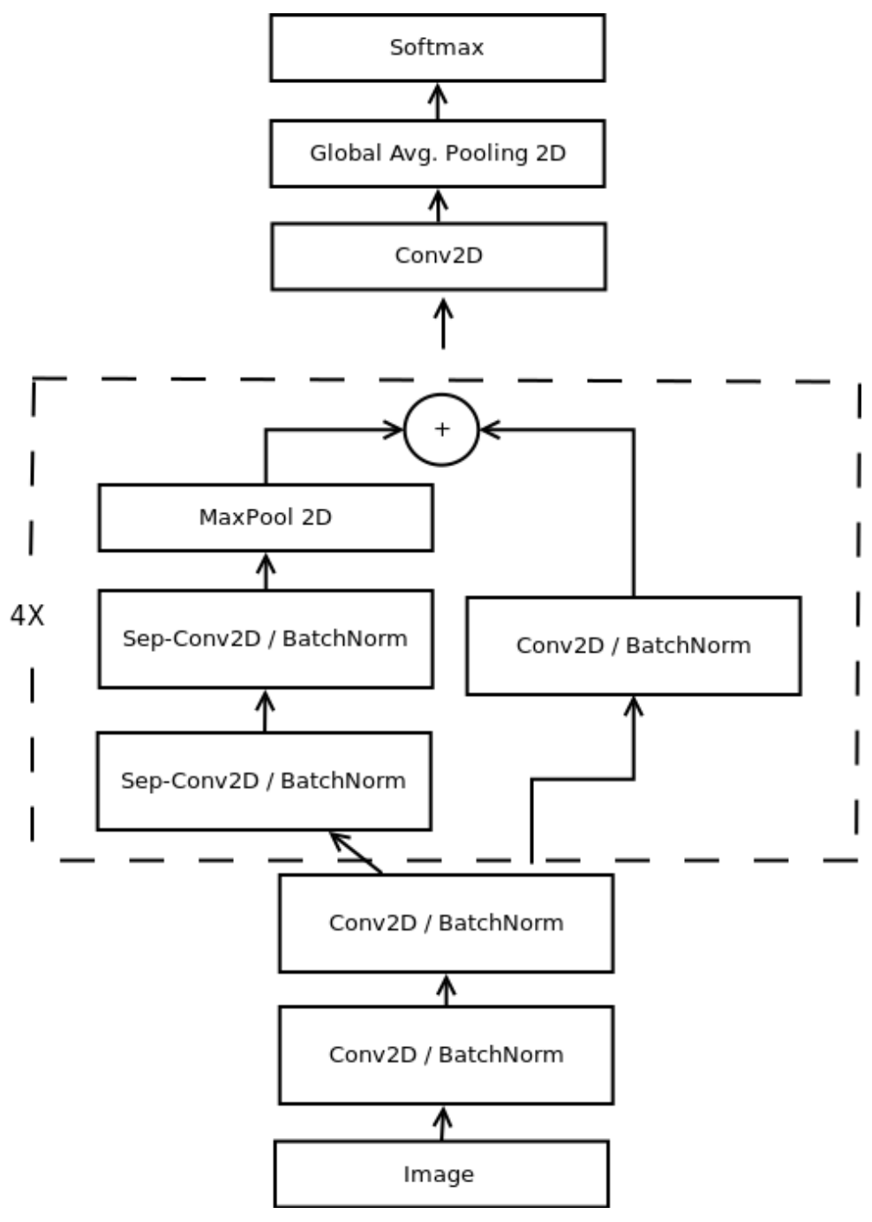
Gender and Emotion Detection
Aaron Thomas Cherian, Bibin Pathiparambil Sebastian, Christine Grace Tharian & Vivek Goddu
Introduction
The dataset used for training of emotion detection is FER 2013. The images have 48*48 fixed resolution and have large variations in the image features. Faces are classified into 6 emotions - angry, disgust, fear, happy, sad, surprise, and neutral.
The dataset used for training gender detection is IMDB_crop gender dataset, consisting of 460,723 face images with gender label.
The model used is inspired by Xception architecture. It combines residual modules and depth-wise separable convolutions.Residual modules modify the desired mapping between two subsequent layers, so that learned features become the difference of the original feature map and desired features.
The training for our model was done without GPU. Due to this, the training was slow.
We achieved accuracies of 67% and 95% for emotion and gender detection respectively.
Novelty: Implemented horizontal ensemble with Xception and Simple CNN models which improved the accuracy by 1-2%.
Classifying the gender and emotion of a person is a fairly simple task for any human being. Here we aim to build such a classifier using CNN
Facial emotion detection has a wide variety of uses in the modern world. It can be:
used in a smart car to detect and alert the driver when he is feeling drowsy.
Used in a job interview to understand the interviewee’s moods and further assess personality traits.
Video games are widely popular nowadays and during the testing phase, emotion recognition could play a vital role in getting product feedback.
Service robotics is another application where a robot is able to extract information from its user’s face and respond accordingly.
Use of CNN model in the above mentioned hardware for such tasks helps us to solve it using fewer parameters than a MLP network. This makes the task computationally feasible in terms of time, space and power consumption.
Model
Results
Fig 1,2 depicts emotion classification
Fig 3,4 predicts the gender of the person
Emotion classifier
Gender classifier
Result
Our project isolates the facial region and detects the gender and emotions of the person. The model is built using Xception architecture. Gender detection is implemented in an iOS app and emotion detection as a desktop app.
Currently, we have implemented the gender and emotion models separately due to conflicting library requirements. We plan to integrate them as future work
Conclusion

